Slide 1
Design of Cyber-Security Enabled Smart Controller for Grid-Connected Microgrid
CSE7101- Capstone Project
Review-1
Batch Number:
Under the Supervision of,
Dr. Ruhin Kouser R
Assistant Professor – Senior Scale
School of Computer Science and Engineering
Presidency University
Roll Number | Student Name
20221CCS0004 | Jason Paul
20221CCS0055 | Adithya Shashidhar
Name of the Program: B.Tech – Computer Engineering (Cyber Security)
Name of the HoD: Dr.Anandaraj S.P
Name of the Program Project Coordinator: Dr.Sharmasth Vali Y
Name of the School Project Coordinators: Dr. Sampath A K , Dr. Geetha A

Slide 2
Problem Statement Number:
Organization: Presidency University
Category (Hardware / Software / Both) : Hardware
Problem Description :
The project aims to design a secure, software and Hardware based smart controller for managing power distribution and control in a grid-connected microgrid environment, integrating cybersecurity features to prevent unauthorized access and data manipulation.

Slide 3
Content
Problem Statement
Objectives
Background and Related work for title Selection
Analysis of Problem Statement
Innovation or Novel Contributions
Git-hub Link
Timeline of the Project
References

Slide 4
Analysis of Problem Statement
Technology Stack Components:
• MATLAB/Simulink – system modelling and simulation
• Raspberry Pi / Arduino – hardware prototype controller
• Python – cyber-attack emulation and anomaly detection
• MQTT / Modbus TCP – communication protocols
• AES Encryption – secure data exchange

Slide 5
Github Link
The Github link provided should have public access permission.
Github Link
https://github.com/J430n14m/Capstone-Project.git

Slide 6
Analysis of Problem Statement (contd...)
Software and Hardware Requirements:
Software Requirements:
OS: Windows/Linux
Python 3.10 / MATLAB R2023a
Libraries: NumPy, Pandas, Scikit-learn, Flask, Cryptography
Git, Visual Studio Code
Hardware Requirements:
Standard PC/Laptop
Optional: Raspberry Pi or Arduino (for simulation extension only)

Slide 7
Analysis of Problem Statement (contd...)
Key Challenges:
-Detecting and mitigating cyber-attacks in real time.
-Maintaining grid stability during an attack.
-Ensuring data confidentiality and integrity.
Proposed Solution:
A software-based controller that monitors data flows, authenticates nodes, and applies security checks before executing control commands.
Use Case:
Grid-connected microgrid with renewable sources (solar, wind) communicating with the control system over a network.

Slide 8
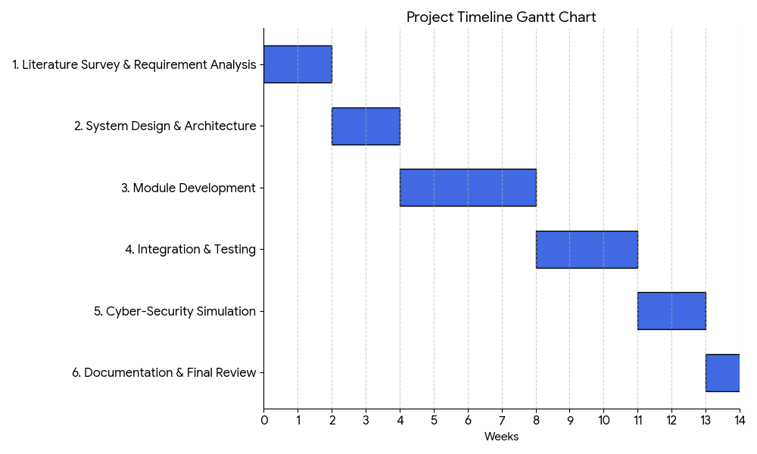
Timeline of the Project (Gantt Chart)

Slide 9
References (IEEE Paper format)
IEEE Transactions on Smart Grid, 2022
IEEE Access – Cyber Security for Microgrids, 2023
Springer – Blockchain in Power Systems, 2022
NIST Guidelines on Smart Grid Cybersecurity, 2020
MDPI Energies – Secure Control Frameworks, 2023

Slide 10


